Slide 1
ECE/CS 552: Consistency and SIMD
Boone Severson
Lecture notes based in part on slides created by Joshua San Miguel, Mikko Lipasti, Mark Hill, David Wood, Guri Sohi, John Shen and Jim Smith

Slide 2
Cache Coherence Problem
A block X can exist in multiple private caches at any given moment. If one core modifies X, unless other cores are immediately made aware of this change, the other cores may read the stale (wrong) contents of X.
P1
P2
assume write-back,
write-allocate L1 cache
Bus
X: 51,40,…
Main Memory

Slide 3
Cache Coherence Problem
A block X can exist in multiple private caches at any given moment. If one core modifies X, unless other cores are immediately made aware of this change, the other cores may read the stale (wrong) contents of X.
P1
P2
X: 51,40,…
1: Load X[0]=51
assume write-back,
write-allocate L1 cache
Bus
X: 51,40,…
Main Memory

Slide 4
Cache Coherence Problem
A block X can exist in multiple private caches at any given moment. If one core modifies X, unless other cores are immediately made aware of this change, the other cores may read the stale (wrong) contents of X.
2: Store X[1]=37
P1
P2
X: 51,37,…
X: 51,40,…
1: Load X[0]=51
3: Load X[1]=40
assume write-back,
write-allocate L1 cache
Bus
wrong value!
X: 51,40,…
Main Memory

Slide 5
Cache Coherence Problem
A block X can exist in multiple private caches at any given moment. If one core modifies X, unless other cores are immediately made aware of this change, the other cores may read the stale (wrong) contents of X.
2: Store X[1]=37
P1
P2
4: Evict X
X: 51,37,…
X: 51,40,…
1: Load X[0]=51
3: Load X[1]=40
assume write-back,
write-allocate L1 cache
Bus
X: 51,40,…
Main Memory

Slide 6
Cache Coherence Problem
A block X can exist in multiple private caches at any given moment. If one core modifies X, unless other cores are immediately made aware of this change, the other cores may read the stale (wrong) contents of X.
2: Store X[1]=37
P1
P2
4: Evict X
---
X: 51,40,…
1: Load X[0]=51
3: Load X[1]=40
assume write-back,
write-allocate L1 cache
Bus
X: 51,37,…
Main Memory

Slide 7
Cache Coherence Problem
A block X can exist in multiple private caches at any given moment. If one core modifies X, unless other cores are immediately made aware of this change, the other cores may read the stale (wrong) contents of X.
2: Store X[1]=37
P1
P2
4: Evict X
X: 22,40,…
1: Load X[0]=51
3: Load X[1]=40
assume write-back,
write-allocate L1 cache
5: Store X[0]=22
Bus
6: Evict X
X: 51,37,…
Main Memory

Slide 8
Cache Coherence Problem
A block X can exist in multiple private caches at any given moment. If one core modifies X, unless other cores are immediately made aware of this change, the other cores may read the stale (wrong) contents of X.
2: Store X[1]=37
P1
P2
4: Evict X
---
1: Load X[0]=51
3: Load X[1]=40
assume write-back,
write-allocate L1 cache
5: Store X[0]=22
Bus
6: Evict X
wrong value of X[1]!
X: 22,40,…
Main Memory

Slide 9
Coherence and Consistency
Coherence: ordering of multiple cores’ reads and writes to one memory location.
Enforces that accesses to memory location are ordered as if they were performed in some sequential order
Consistency: ordering of multiple cores’ reads and writes to all memory locations.
Sequential consistency (SC) model: Enforces that accesses to all memory locations are ordered as if they were performed in some sequential order
Relaxed consistency models exist to improve performance

Slide 10
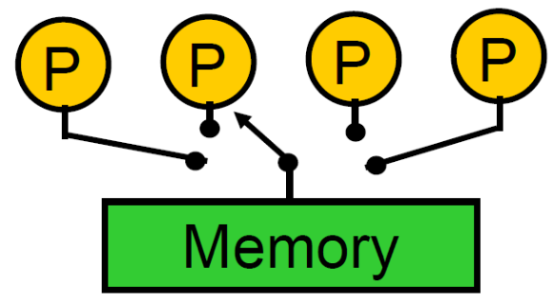
Sequential Consistency
To achieve sequential consistency, it should appear as if:
Intra-thread program order: Each individual core’s reads and writes occur in program order.
Inter-thread serialization: All memory reads and writes from all cores are globally serialized.
load X
load X
store X
store X
load Y
store Y
load Y
store Y
Inter-thread write atomicity: All memory writes are globally serialized and all cores agree on the order.
only writes have to be serialized;
reads can happen in parallel

Slide 11
SC Example
Possible result with SC: (A=0, C=0)?
No
// init
*x = 0; *y = 0;
// P1
*x = 8;
A = *y;
// P2
B = *x / 2;
...
*y = 5;
C = *x / 2;

Slide 12
SC Example
Possible result with SC: (A=0, C=0)?
No
// init
*x = 0; *y = 0;
// P1
*x = 8;
A = *y;
// P2
B = *x / 2;
...
*y = 5;
C = *x / 2;
// P2
B = *x / 2;
...
*y = 5;
C = B;
compiler:
common subexpression elimination
(A=0, C=0)
SC violation!

Slide 13
SC Example
Possible result with SC: (A=0, C=0)?
No
// init
*x = 0; *y = 0;
out-of-order processor
// P1
*x = 8;
A = *y;
// P2
B = *x * 2;
...
*y = 5;
C = *x * 2;
// P2
B = *x / 2;
...
*y = 5;
C = *x / 2;
(A=0, C=0)
SC violation!

